Slide 2
Agenda
Welcome & Introductions
Slide Presentations
Question & Answer Time

Slide 3
Mission & Purpose of PLN
Our Mission
To foster and strengthen Extension education programming throughout the southern region by:
Promoting multistate cooperation
Anticipating emerging program issues and needs
Implementing action processes to address them in a timely manner

Slide 4
Do you know?
Which southern region state has the trio:
1862, 1890, & 1994 land-grant universities?
Oklahoma

Slide 5
Promoting Cross-Committee Efforts
Sharing agendas ahead of time
splc-regional-chair@lists.msstate.edu
Topics that may need multi-committee involvement – officers hyperlinked on website
Other ideas?

Slide 6
Conference Highlights: Monday
1:00 pm CDT/2:00 pm EDT
PLC Meeting w/ Committee Chairs
Followed By PLN Executive Committee Meeting
(Note: Committee Chairs can come at 1:30 Central/2:30 Eastern)
3:00 pm CDT/4:00 pm EDT
Newcomer Orientation: Chairs/Vice Chairs Attend
List of Newcomers Will be Provided Ahead of Time

Slide 7
Virtual Fun Run/Walk!
Register at Conference Registration
You Decide Whether You Walk or Run, and Distance
More Details at Registration

Slide 8
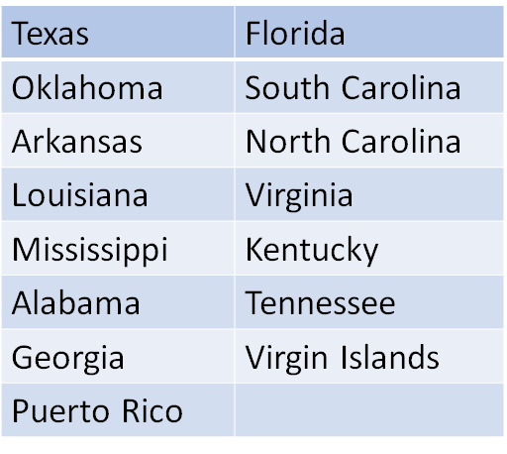
Do You Know?
The states/territories
in the SR-PLN Region?

Slide 9
Conference Highlights: Tuesday
Keynote Speaker:
M. Christopher Brown, II, Ph.D.
President
Kentucky State University
Virtual Programming Lessons Learned
Awards Presentation
Social Hour (Optional; 3:15 pm CDT/4:15 pm EDT)
Wear Your University Colors!

Slide 10
Time with Administrative Advisors
Tuesday
12:30 pm – 2:15 pm CDT
1:30 pm – 3:15 pm EDT
Wednesday
1:00 pm – 2:30 pm CDT
2:00 pm – 3:30 pm EDT
Actions and Accomplishments Due
Plan for these times to include high priority discussions where Administrator input is needed.

Slide 11
Do You Know?
How many committees make-up the SR-PLN?
Eight (8)

Slide 12
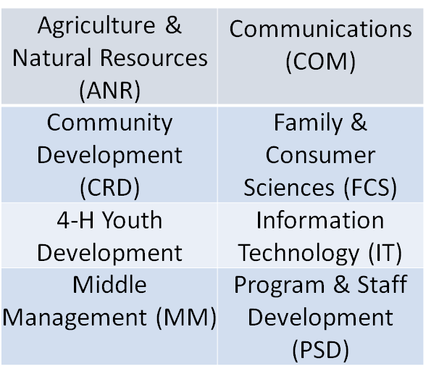
Do You Know?
The name of the committees that make-up the SR-PLN?

Slide 13
Housekeeping Items: Optional State Reports
Committee’s Choice
Options to maximize meeting time:
Post online
Review on a conference call prior to meeting

Slide 14
Housekeeping Items:
Update 2020-21 Plan of Work
Due Wednesday, August 25th at 3pm CDT/4pm EDT
Select “Committees” tab
Select your committee
Select “2020-21 Plan of Work” DOC
Make changes to the last column & other places as relevant
E-mail to: russ.garner@msstate.edu
http://srpln.misstate.edu/
Can be completed pre-conference!

Slide 15
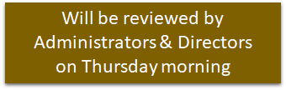
Housekeeping Items: Create New 2021-22 Plan of Work
Due Wednesday, August 25th at 3pm CDT/4pm EDT
Template posted on PLN site
Include NEW officers & PLC representatives
Include conference call schedule (dates/times)
If using virtual meeting links (such as Zoom) instead of conference calls, please provide link information.
E-mail to russ.garner@msstate.edu

Slide 16
Housekeeping Items: Elect Officers & PLC Representatives
Report new officers on 2021-2022 Plan of Work
1862/1890 PLC Representatives: 3 years
Officers: 1 year, but can move up chain
New 1890/1862 PLC Reps. and current Reps. to PLC virtual meeting Thursday, August 26th, 8:30 a.m. Central/9:30 a.m. Eastern

Slide 17
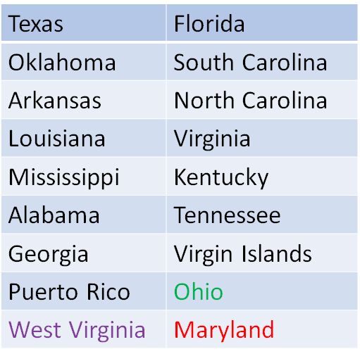
Do You Know?
The states/territories that participate
in the SR-PLN?

Slide 18
PLC Representatives Completing Terms
ANR: Clarence Bunch (1890)
COM: Lisa Stearns (1862)
4-H : Manola Irby (1890)
IT : Steve Garner (1862)
MM : Gerald Jones (1890)
PSD: Meredith Weinstein (1862)

Slide 19
Housekeeping Items: Update Members’ List & Listserv
Due Wednesday, August 25, by 3pm Central/4pm Eastern
Copy of current list provided via email
Share list in committee meeting
Listserv: Primary email address (no aliases)
Return updated list to russ.garner@msstate.edu
Send updates throughout the year to:
russ.garner@msstate.edu

Slide 20
Housekeeping Items: Action Items
Due Wednesday, August 25, by 3pm CDT/4pm EDT
Template for Action & Accomplishment Items provided
Please do not change fonts or styles as these must be combined for presentation.
E-mail to russ.garner@msstate.edu
Provide a cell phone
number for quick clarifications.

Slide 21
Action Item – Only If…
Clear & Concise Proposal that:
Requires a commitment of resources across 1862 and 1890 institutions
Changes established practice
Impacts others outside of the committee
A proposed
activity or policy decision
needing
joint
AEA and ASRED
administrator approval.

Slide 22
Action Item: Good Example
Health Disparities: Family and Consumer Sciences
Background: A regional meeting of FCS Program Leaders & Specialists is needed to:
Provide professional development in the area of health disparities;
Explore opportunities for multi-state and interdisciplinary efforts;
Form teams to write proposals for funding, development or adoption of health curricula across the region.
Action Requested: Approval for regional meeting
Timeline: September 1, 2021 - August 31, 2022

Slide 23
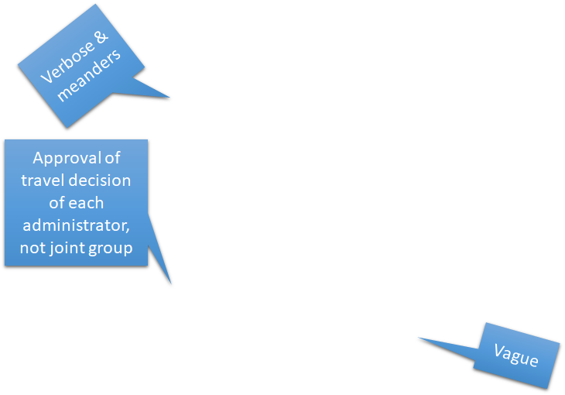
Action Item: Poor Example
Encourage Participation in National Meetings:
Background – Faculty of state Extension organizations have more opportunities to collaborate with colleagues on a broader scale. Participation in national meetings would give faculty more opportunities to network with their counterparts and learn of ongoing activities in which they can partner. Extension leadership is asked to consider supporting the increase in attendance by faculty to national meetings that could improve relationships and collaboration between state organizations.
Committee(s) Involved – All committees
Action Needed – Approval for professional faculty/staff
to attend national meetings.
Timeline – 2021 and beyond.

Slide 24
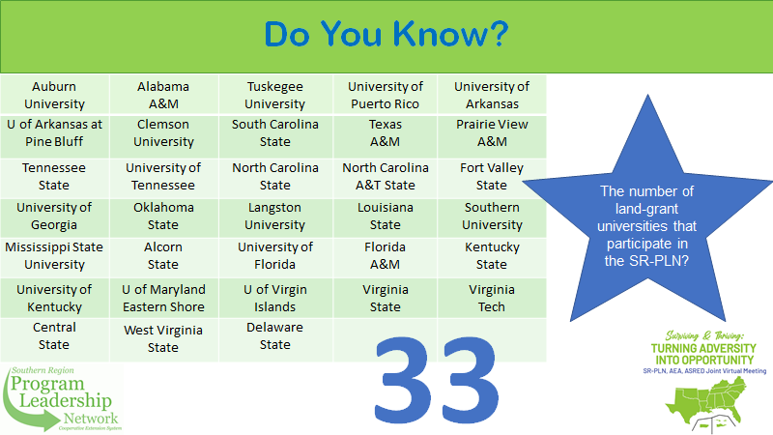
Do You Know?
The number of
land-grant universities that participate with the SR-PLN?
Auburn University | Alabama A&M | Tuskegee University | University of Puerto Rico | University of Arkansas
U of Arkansas at Pine Bluff | Clemson University | South Carolina State | Texas A&M | Prairie View A&M
Tennessee State | University of Tennessee | North Carolina State | North Carolina A&T State | Fort Valley State
University of Georgia | Oklahoma State | Langston University | Louisiana State | Southern University
Mississippi State University | Alcorn State | University of Florida | Florida A&M | Kentucky State
University of Kentucky | U of Maryland Eastern Shore | U of Virgin Islands | Virginia State | Virginia Tech
Central State | West Virginia State | Delaware State
33

Slide 25
Accomplishments: 1 Slide per Committee
2-3 bullets describing committee’s major accomplishments
Short & to the point
Draw from past year’s Plan of Work
Demonstrate the value of your participation in this meeting

Slide 26
Accomplishment Examples
Established a multi-state grant writing team on food safety
Identified three common indicators for committee use across the South
Completed a position paper on the value and impact of integrated strategic communications

Slide 27
Evaluations
Qualtrics-based survey
Will launch Wednesday afternoon
Encourage participation
The data is used to guide next year.

Slide 28
Technology Details
A Zoom Link to the General Session Will be Provided After Registration, But Before Meeting Week
Each Committee Will be Responsible for Providing Zoom Links for Committee Meetings

Slide 29
Follow Up
After This Session, These Resources Will Be Available:
A Link to a Video of This Session
The PowerPoint of This Session
Committee Deadline Sheet
PLN Structure Slide
And More!!!!!

Slide 30
Questions or Discussion?

